Slide 1
Into to Git
Air-Worldwide Inc. Integration group. Alexey Tsepota. August 2017

Slide 2
Agenda
What is GIT
Main Definitions
Main Commands
Under the hood
Clone, Branch, Merge, Rebase
Pull requests

Slide 3
Git. In Short
Created by Linus Torvalds, creator of Linux (2005, written in C)
Uses a lot of SHA1 hashes – algorithm to get 160 bit hex number from the context.
SHA1 hash identifies the file.
Source: https://git-scm.com/download/win in powershell: git –version
Configuration: c:\Program Files \ Git\ etc\gitconfig
Any directory now can be converted into Git directory by using ‘git init’ command in command line
Most used command:
‘git status’ , ‘git add’ – staging; ‘git commit’ – commit the files into repo, ‘git log’, ‘git checkout’

Slide 4
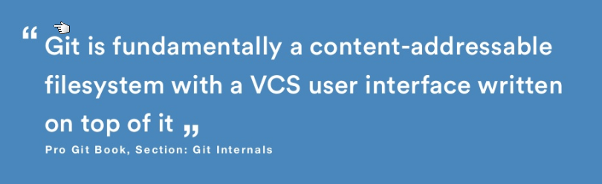
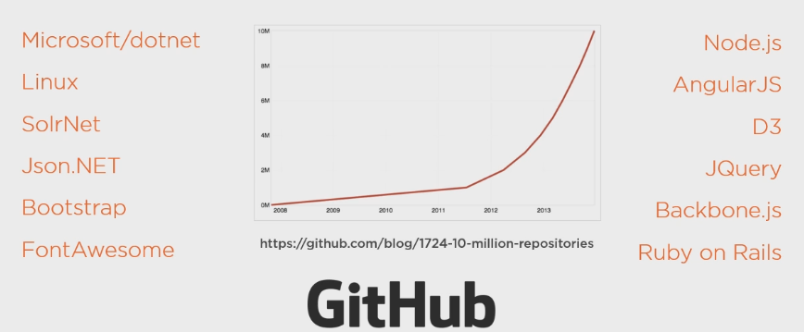
Git. What and Who is using it
Uses snapshots instead of deltas

Slide 5


Git. Main features
Git is:
Open source
Distributed (SVN, Teamcity are Centrilized)
Version control system designed for speed and efficiency
At any particular moment your machine contains a full copy of the repository with all its branches, history and file contents.
In short: you don’t need connection to the server to work (perform a diff, view history, commit changes, merge branches, get other revision of a file, switch between the branches).
(almost) everything is local.
Everything is fast.
Every clone is a backup.
Go online only and when you need to push/save/share your changes with the rest of the team.

Slide 6

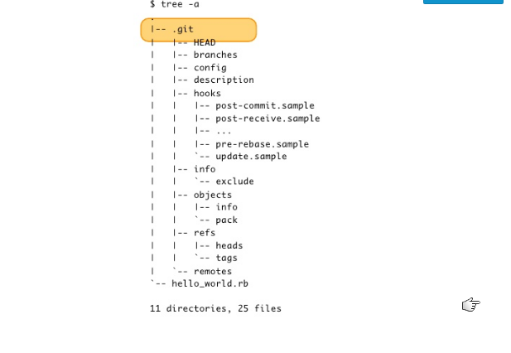
What is Git. Local repo
Usual directory structure for Git
.git folder content (folders): - HEAD
Branches
Config
Description
Hooks
Info
Objects
Refs
Remotes

Slide 7
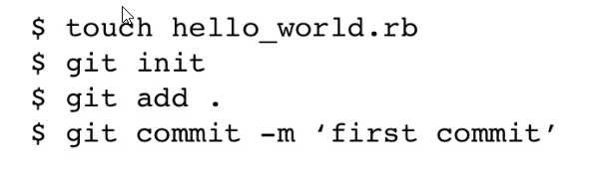
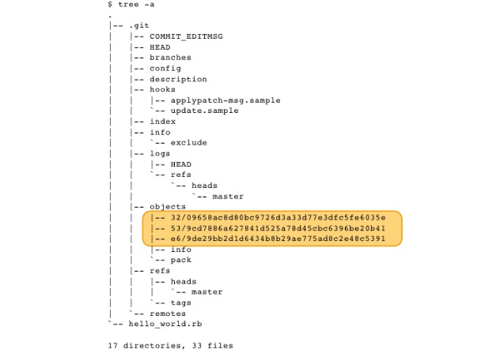
What is Git
Usual directory structure for Git
.git folder content (folders): - HEAD
Branches
Config
Description
Hooks
Info
Objects
Refs
Remotes

Slide 8

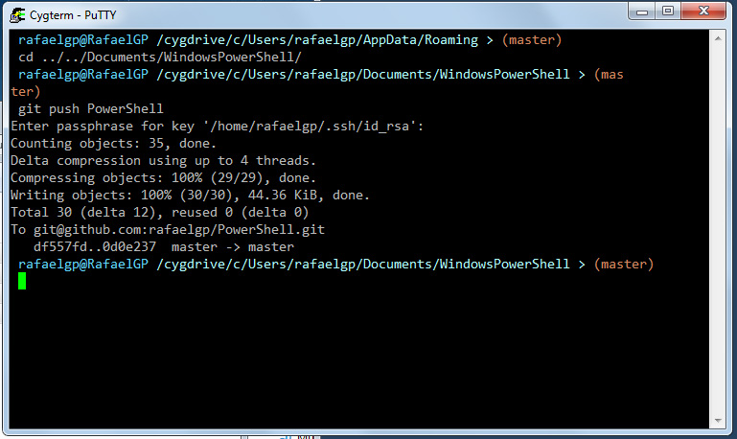
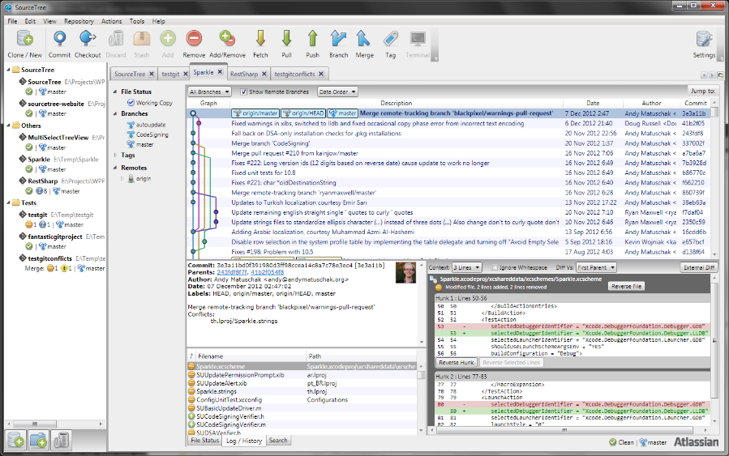
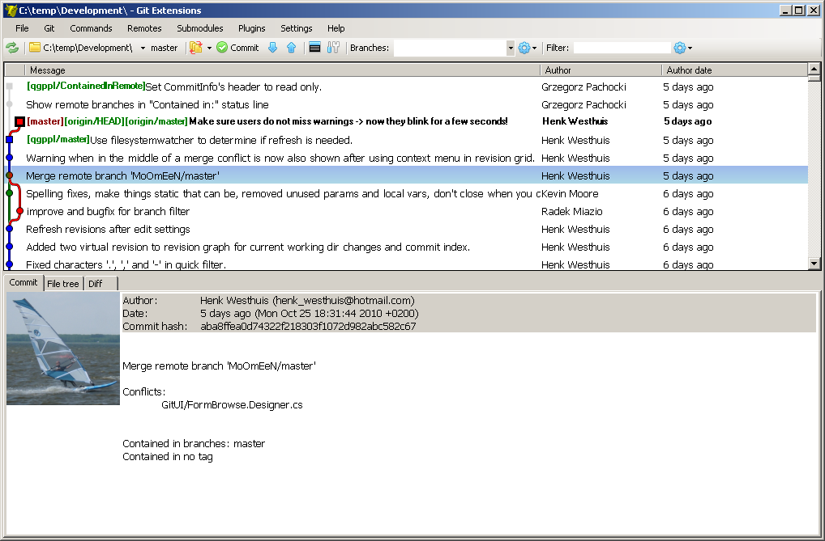
Working with Git
Should have the git server where all the members of the team commit
their changes. Popular servers: ‘GitHub’.com and ‘Bitbucket.com’
Initial command: ‘$git clone ‘directory’(git://github.com/somerepository.git)
Work with command line or the GUI program. Choose the one you like. GitExtensions,SourceTree
For version 1.7 there are 152 Git commands

Slide 9
Git. Important definitions
“Working tree”
Is the directory where you can edit the files
“INDEX”
Is an intermediate cache for preparing a commit
“STAGE” COMMAND
Allows you to save a file’s content from your working tree to the index

Slide 10
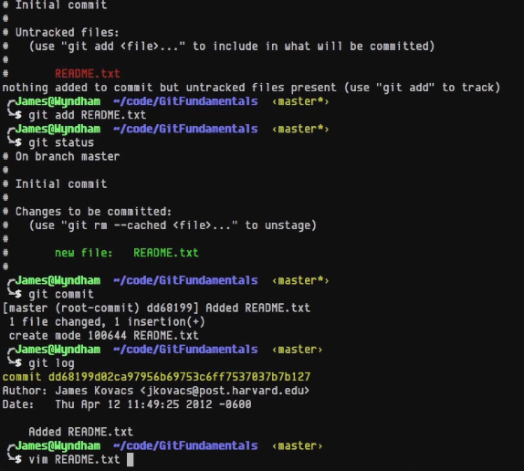
Git. Most Used Commands. Command line
‘git status’
Gives us the list of all not tracked files and changes
‘git add’
Adds the file into the index for tracking
‘git commit’
Adds all the staged files into the repo
‘git log’
Gives you the information about the latest commits, latest commits go first
‘git checkout’ – places specific commit in working area, moving HEAD pointer
158 commands in version 2.14

Slide 11
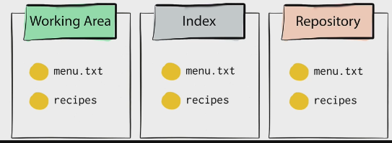
Git. Under the hood. Areas
git ‘Add’ - move to staging (index) – must moves data
git ‘Commit’ – moves the data and changes the repository (Branch is pointing to a new commit, HEAD is not changed)
git ‘checkout’ – moves the data from repository to working area, changes the repository (head)

Slide 12
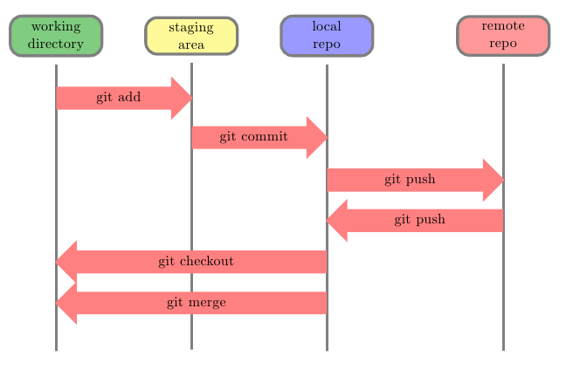
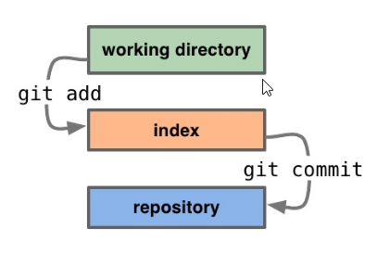
What is Git. Basic Workflow
Edit Files
Stage the changes
Review the changes
Commit the changes

Slide 13
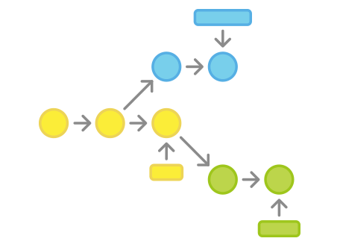
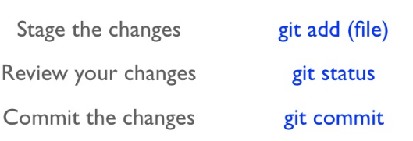
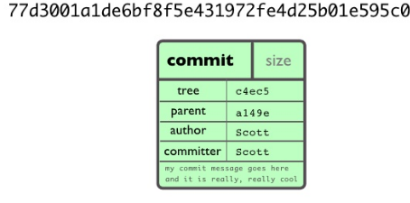
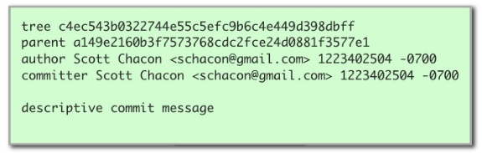
What is Git. Basic Workflow. Commit
The commit object name is a part of SHA1 encoded content of the commit object. It has several properties:

Slide 14
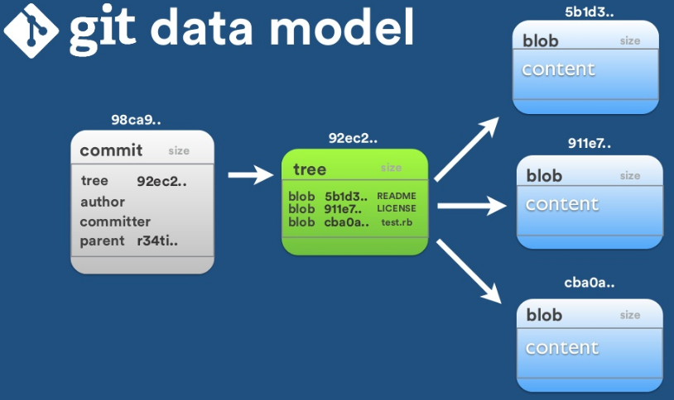
What is Git. Basic Workflow. Commit

Slide 15
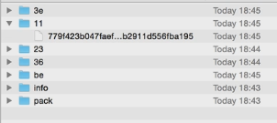
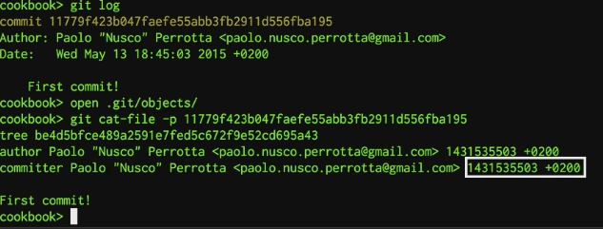
Git. Under the hood. Inside Commit
Inside the commit object we have Commit Description + Tree object
Tree object describes the file structure/contents that is in place at the time of the commit
git cat-file sha1 –t (type); git cat-file sha1 –p (actual content)

Slide 16
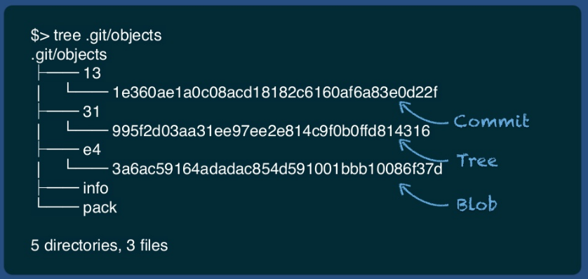
Git. Basic Workflow. Tree

Slide 17
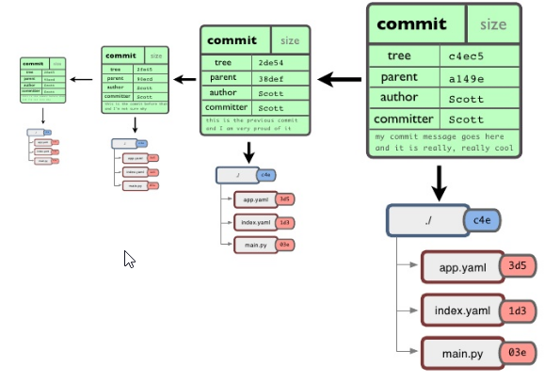
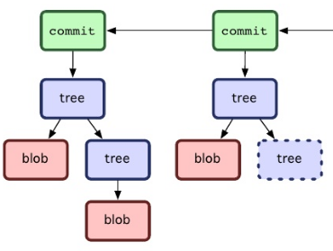
Git. Basic Workflow. Tree
Every file is saved in the form of BLOB object. Again, SHA1 encoded and zipped.

Slide 18
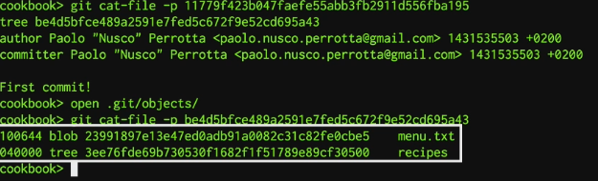
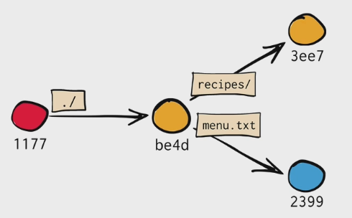
Git. Under the hood. Inside Tree
The tree object (unzipped) has either number of ‘Blobs’ (actual files and contents) or other ‘Trees’ (directories)
> Commit
> Description + (parent)+ Root File Tree > Blobs(Files) + Trees(Folders)

Slide 19
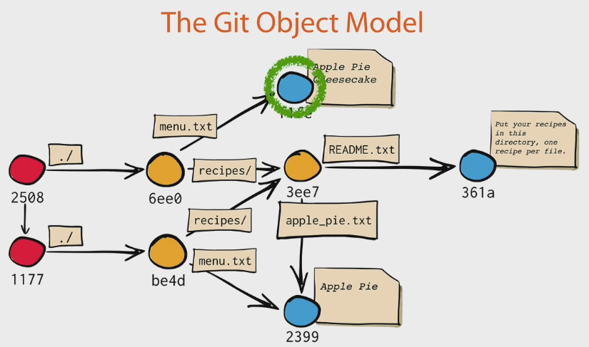
Git. Under the hood. More Commits
The new commit creates a new root tree object (6ee0).
If the file in that new commit has changes, Git creates a new blob for a file (menu.txt)
If not, Git reuses the object already created (‘recipes’ folder not changed).

Slide 20
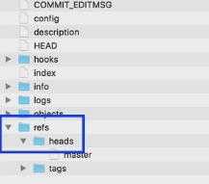
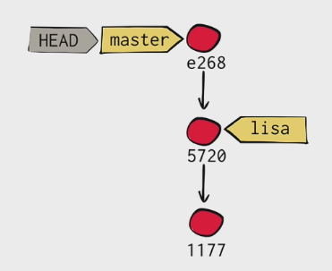
Git. Under the hood. Branches
Branches objects located in ‘refs/heads’ folder in .git directory
We can create a new branch just creating a new file in this directory
OR
Git branch ‘branchname’
Branch is just a pointer to a specific commit
HEAD object has the reference to one of the branches in ‘refs/heads’ folder
By that we know what is our current branch (or specific commit that is loaded in our working directory)

Slide 21
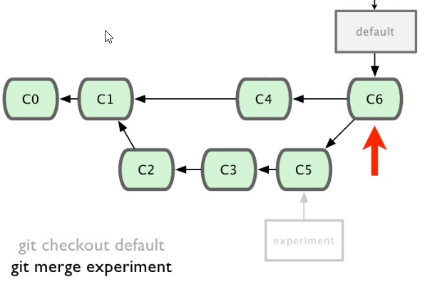
What is Git. Basic Workflow. Merging
Now my ‘merge’ command we creating a new commit with the changes merged together from
C4 (default branch) and C5 (experiment branch). C6 has the parents from two branches.

Slide 22
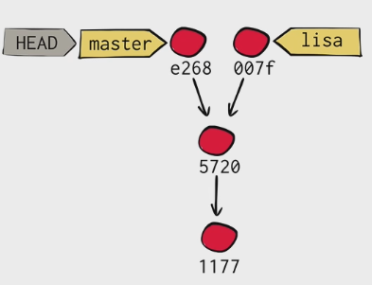
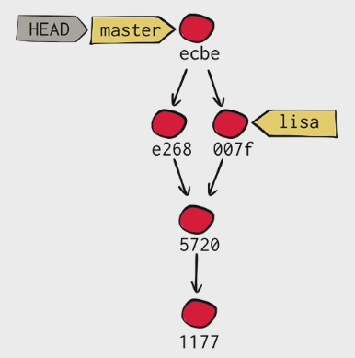
Git. Under the hood. Branches. Merges
Check out ‘master’ branch AND ‘git merge lisa’ branch
Sometimes there are the conflicts
The commit/merge has 2 parents inside the Commit Object
HEAD object has the reference to one of the branches in ‘refs/heads’ folder
By that we know what is our current branch (or specific commit that is loaded in our working directory)

Slide 23
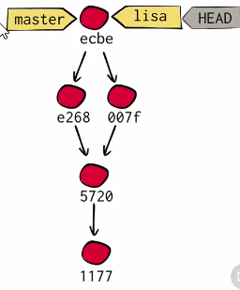
Git. Under the hood. Fast forward
When you checkout Git just replaces the working area with the files from the object database. Nothing else.
When we merged ‘master’ with ‘lisa’ we created the commit that has all changes from ‘master’ and ‘lisa’ in the files.
But branch ‘lisa’ is still pointing to 007f commit as we didn’t merge it with ‘master’. Should we create a new commit merging this time ‘lisa’ and ‘’master’? But we already have such a commit.
FAST-WORWARD (!) the branch. Basically skipping creating a new merge commit , and moving the branch pointer to the existing commit that has all the merges needed.
MERGE WITHOUT CREATING A SEPARATE COMMIT

Slide 24
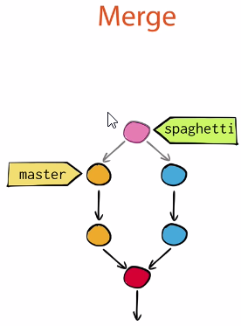
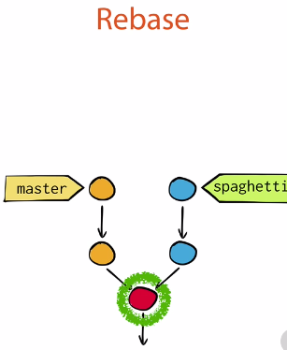
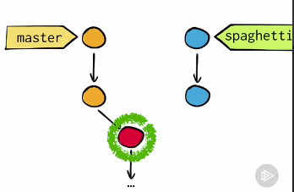
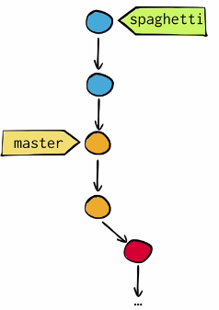
Git. “Rebase” vs “Merge” command
VS
We are changing the base of the branch, so we call it ‘rebasing’. There could be conflicts, that needs to be resolved.
‘Spagetti’ branch right now contains All the changes from ‘Master’ branch + ‘Spagetti’ (like in Merge).
Now we can just could ‘checkout’ Master and ‘rebase’ with ‘spaghetti’ or just ‘merge’ with ‘spaghetti’.

Slide 25
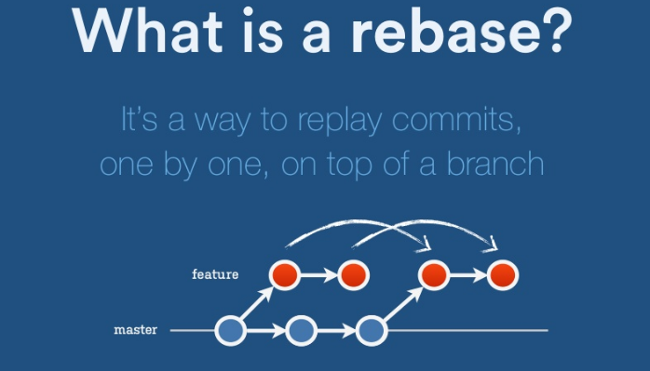
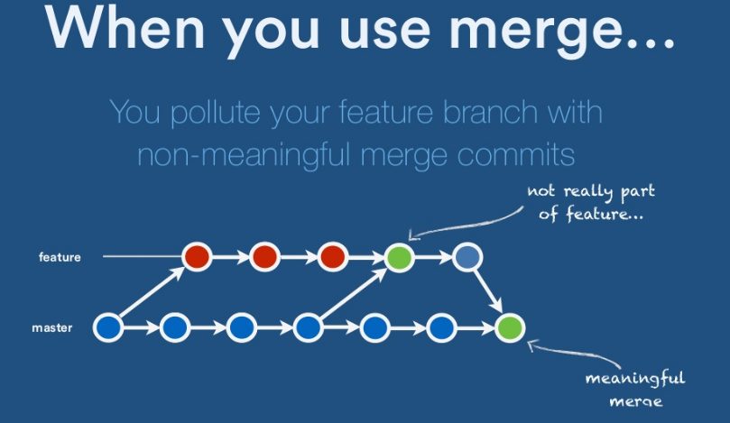
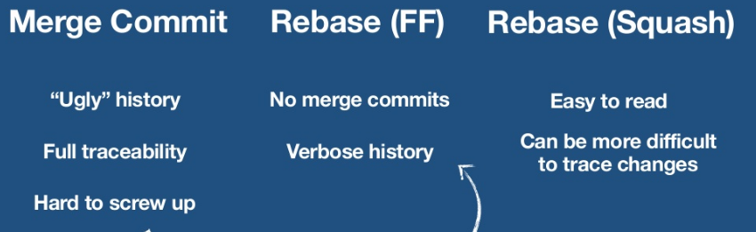
Git. “Rebase” more

Slide 26
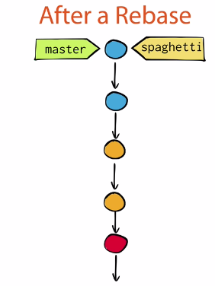
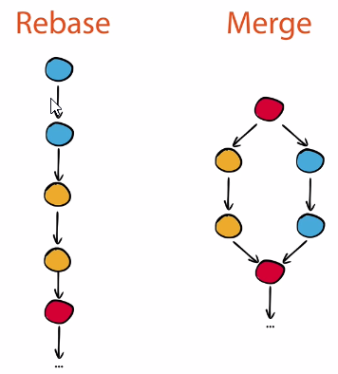
Git. “Rebase” more
The same effect as ‘merge’ command :
the changes from one branch are moved to another.
The difference: all the commit from one branch are recorded at upstream branch.
The cut-off point is calculated as the common ancestor between your current branch and the provided upstream branch.
NEVER ever rebase a branch that you pushed already, or you pulled from another person. BASICALLY, never rebase from the public branch EVER (unless you really would like to learn GIT very well, as you will have to fix the conflicts manually).

Slide 27
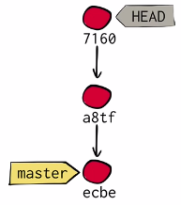
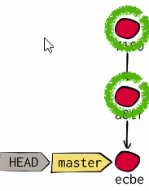
Git. Detached Head
This exact state - when a specific commit is checked out instead of a branch
is what's called a "detached HEAD".
When you instead choose to check out a commit hash, Git won't do this for you. The consequence is that when you make changes and commit them, these changes do NOT belong to any branch.
This means they can easily get lost once you check out a different revision or branch: not being recorded in the context of a branch, you lack the possibility to access that state easily (unless you have a brilliant memory and can remember the commit hash of that new commit...).
What about going back in time to try out an older version of your project? For example in the context of a bug, you want to see how things worked in an older revision.
This is a perfectly valid and common use case. However, you don't have to maneuver yourself into a detached HEAD state to deal with it. Instead, remember how simple and cheap the whole concept of branching is in Git: you can simply create a (temporary) branch and delete it once you're done.
If there are some commits that cannot be reached using any of the branches, those commit objects sooner or later will be garbage collected by Git
So, if you need to save those ‘lost’ commit just checkout them and create a new branch on them.

Slide 28
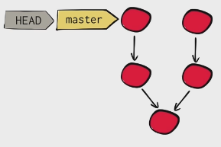
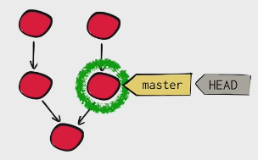
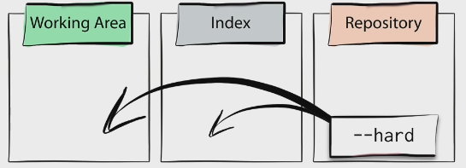
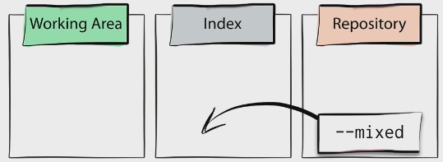
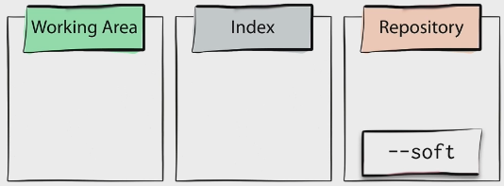
Git. “Reset” Command
Moves the pointer for a branch to specific commit
‘Reset’ does not move the HEAD, it still points to the same branch
‘Hard’ option: just copies the files from Repository to Working and Staging
‘Mixed’ = Default: Working AS IS (!), but copies repository to Stating
‘Soft’ option: just assign Branch to the different commit in Objects database
‘Reset’ updates the current branch and optionally copies the data from Repository to the Areas

Slide 29
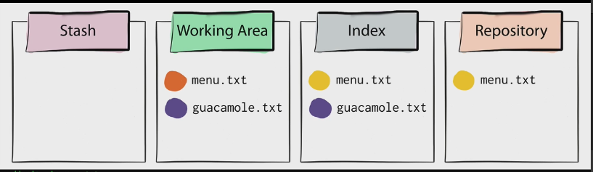
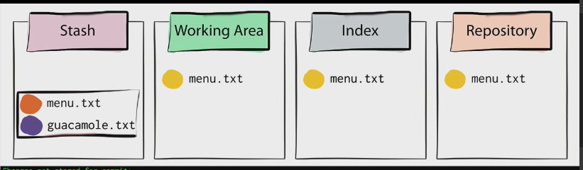
Git. “Stash” Command
git stash
>
As you can see, we have changed ‘menu.txt’ but not staged or committed
We have guacamole.txt’ staged but not committed (placed into objects repository)
Removes all the unstaged and staged files from the Working Area and Copies fresh set from Repository for the current pointer to the commit

Slide 30
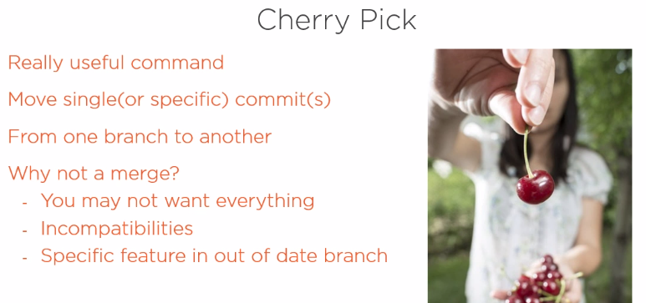
Git. “Cherry pick” command
When you move a single commit from one branch to another

Slide 31


Git. “Blame” and “Search” command
When you are looking for the author of a particular change in a file. Gives you an opportunity to see in what commit a change was introduced.

Slide 32

Git. Tagging
Usually we add a Tag to a specific Release Commit, so we can find it later easier.

Slide 33

Git. Real workflow.
Clone the code that is in production (MASTER branch)
Create a branch for feature #12
Work for 10 minutes
Boss asked for urgent hotfix for issue #323
Checkout Master branch again
Create a branch for issue #323
Fix the issue #323
Checkout Master branch AND send ‘merge’ command with branch for #323
Push back to the repository the local changes on Master branch
Checkout branch for feature #12 (locally) and keep working

Slide 34

Git. Real workflow.

Slide 35

Git. Real workflow.

Slide 36

Git. Real workflow.

Slide 37


What is Git. Fetch. Pull. Push
Fetch just gets the commits that not present in your working area
Pull not only gets the commits but also
merge them with the files in your working area

Slide 38

What is Git. Types of Repository Policy
Dictator decides when to make the merges to the Master branch from the developers
Developers get the latest changes by pulling from the Master branch.
Pull requests

Slide 39
Git. Demo. Fun, fun fun… ☺
Creating repo and Clone
Go to local, open the .git folder
‘Master’. First change, first staging, first commit, first push, back to GitHub
Change file on a server, do Pull on local branch
Create a new branch, change the same file
Switch between the branches, see the files are replaced in Working Area
Example of Merge vs Rebase (new branch, a couple commits, back to master, merge, hard reset in master)
Switch to BranchToRebase, on master (basically it is almost we never branchout from Master, just created a couple commits and at the latest created a new branch named ‘BranchToRebase’ and assigned latest commit to newly created branch). All we have to do now is just ‘Fast Forward Merge’ the Master branch.
Example of Squash. Do it on private (!) branch. (create a new file in 3 new commits). Squash with Previous.
Add something to the previous commit
Stashing. Change.Stage.Stash. Apply
CherryPicking (create branch, add needed, add unneeded, switch, cherry pick, delete branch with ‘force’)
Blaming and Search (different tab, search for commit message); Blaming you can see all the changes for a file and figure out in what exactly commit they happen
Reset (Delete) – 3 different options (you can still recover hard deleted commits (still have the time))
(git fsck - -lost-find – file system consistency check) – list of ‘lost’ commits, git reflog, git show SHA1, git merge
Revert Commit (create a new commit in which you are reversing a previous commit)

Slide 40
Git.
The End

